Slide 1

PROJECT
ASP
ASP Midterm Project
潘俊宏N96111037 郭承宗Q36134027 陳致融E14109022
ASP Team18
Project
2024.5.31

Slide 2
PROJECT
ASP
Agenda
LMS Algorithm
NLMS Algorithm
APA Algorithm
Performance Analysis & Conclusion
LMS versus NLMS
Fixed frequency & Dynamic SNR
Fixed SNR & Dynamic frequency
APA versus NLMS
Convergence Test
Fixed SNR & Dynamic frequency
Fixed frequency & Dynamic SNR
ASP Team18
Project

Slide 3
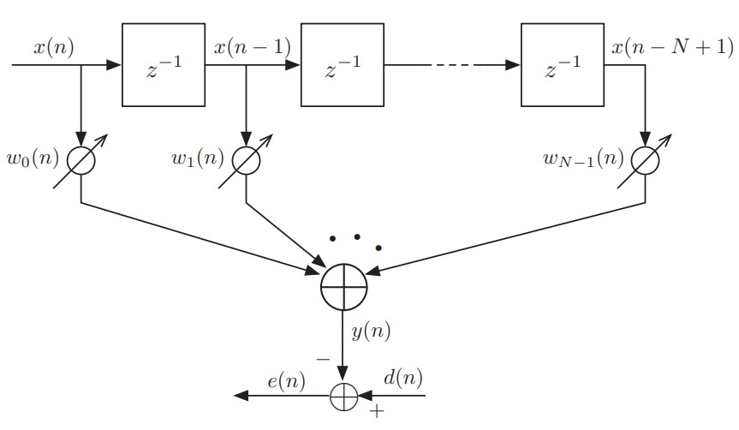
PROJECT
ASP
LMS algorithm
Replace x(n), w(n) representation
ASP Team18
Project

Slide 4
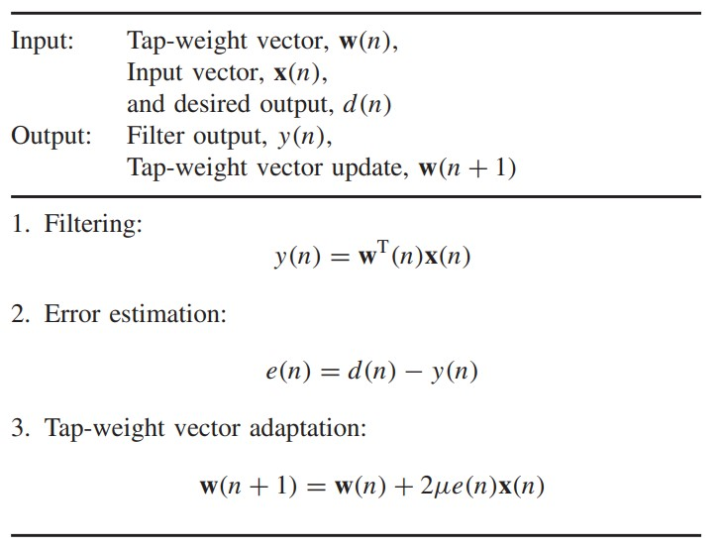
PROJECT
ASP
LMS algorithm
ASP Team18
Project

Slide 5
PROJECT
ASP
LMS algorithm
∇ is the gradient operator
Derivation of LMS algorithm
Replace estimate
Cost function
By steepest - descent method
Substituting ξ in the steepest-descent recursion
, µ is the step-size
∇ is the gradient operator
The eminent feature of the LMS algorithm, is its simplicity.
Its implementation requires, 2N + 1 multiplications and 2N additions.
ASP Team18
Project

Slide 6
PROJECT
ASP
LMS algorithm
∇ is the gradient operator
LMS algorithm convergence
optimum tap-weight vector
definition weight-error vector
optimum recursion equation
orthogonality
independent
is correlation matrix of the input vector x(n)
Convergence to zero
is the maximum eigenvalue of R
ASP Team18
Project

Slide 7
PROJECT
ASP
NLMS algorithm
∇ is the gradient operator
Normalized LMS algorithm
LMS algorithm problem :
When the adjustment amount of the tap weight (N) is proportional to the input vector x(n)
gradient noise amplification problem (梯度躁聲放大)
LMS recursion equation
, µ is the step-size
Idea : Modify the step size µ in the LMS algorithm, make it have time-varying µ(n)
Considered a constrained optimization problem in LMS
Use Lagrange multiplier method solve it
ASP Team18
Project

Slide 8
PROJECT
ASP
NLMS algorithm
∇ is the gradient operator
Lagrange multiplier method
Cost function
derivative by to find extremum value
time-varying µ(n)
In developing the normalize LMS algorithm, when is small, numerical difficulties may arise. To overcome this problem, we add a relax value ($ε$) in denominator.
Recursive equation
Note : The eminent feature of the NLMS algorithm, it is more complexity than LMS algorithm. Its implementation requires 3N + 1 multiplications
ASP Team18
Project

Slide 9
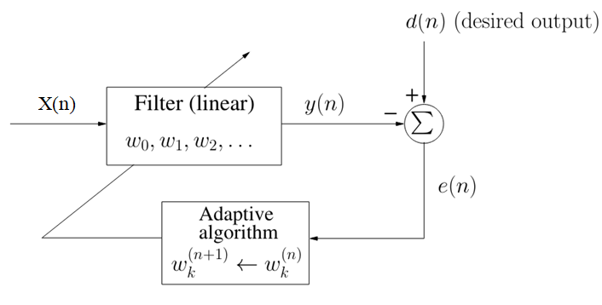
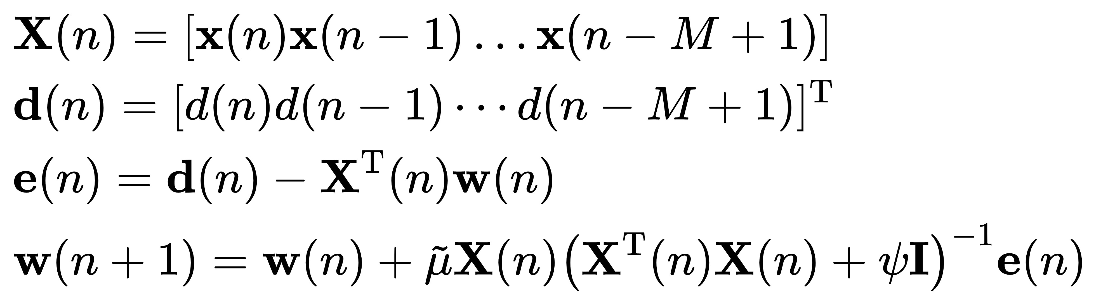
PROJECT
ASP
Affine projection algorithm
ASP Team18
Project

Slide 10
PROJECT
ASP
Affine projection algorithm
ASP Team18
Project

Slide 11
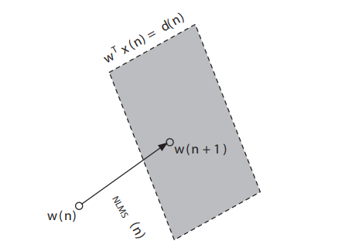
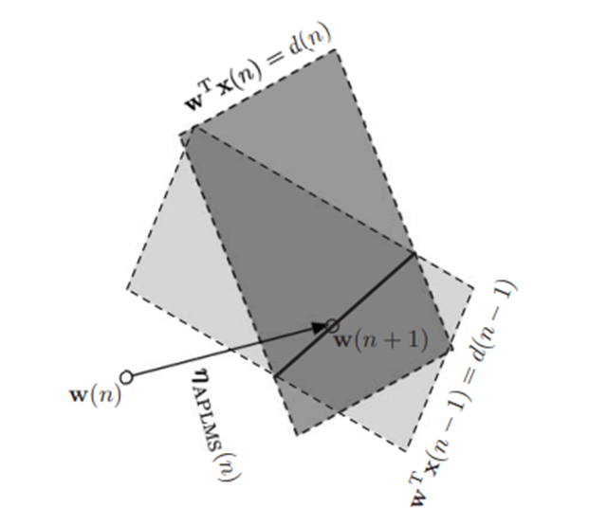
PROJECT
ASP
Affine projection algorithm
Geometrical interpretation of the NLMS
2 constraints of the Affine projection algorithm
ASP Team18
Project

Slide 12
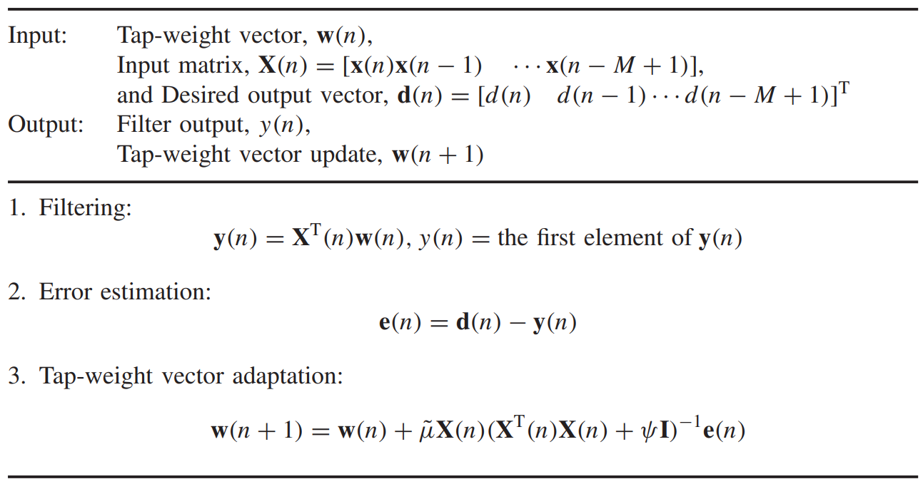
PROJECT
ASP
Affine projection algorithm
ASP Team18
Project

Slide 13
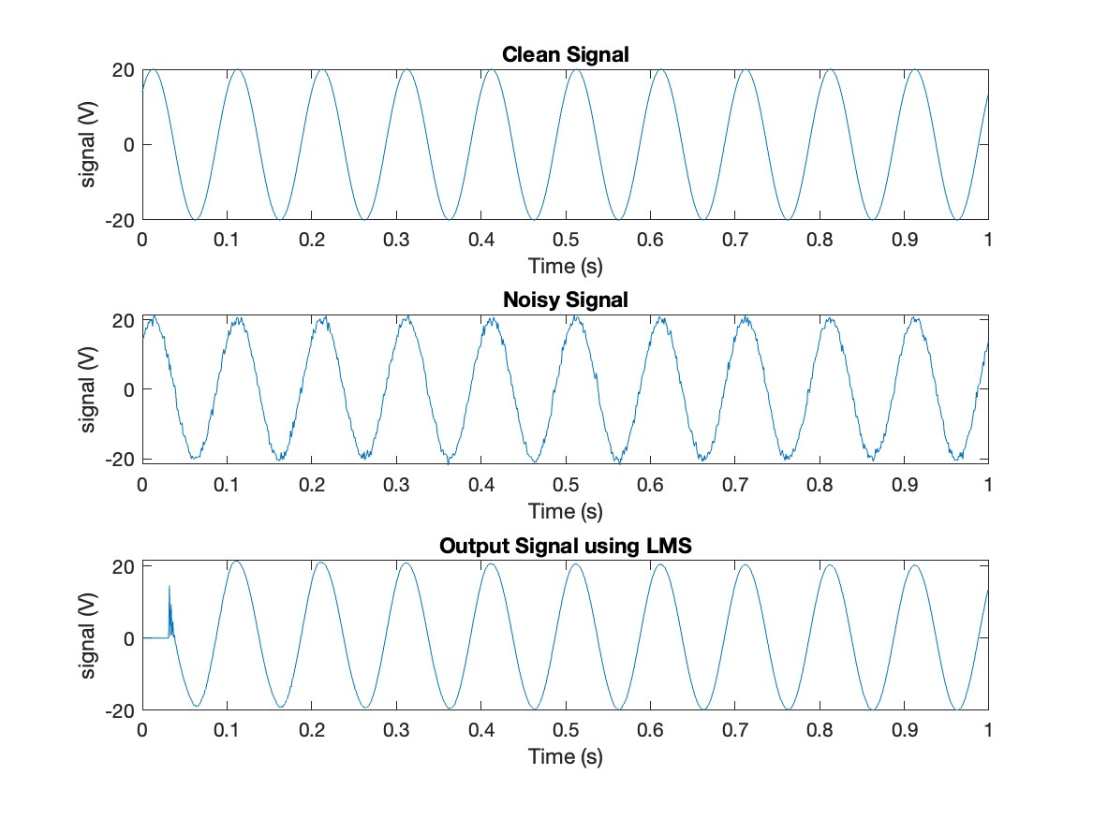
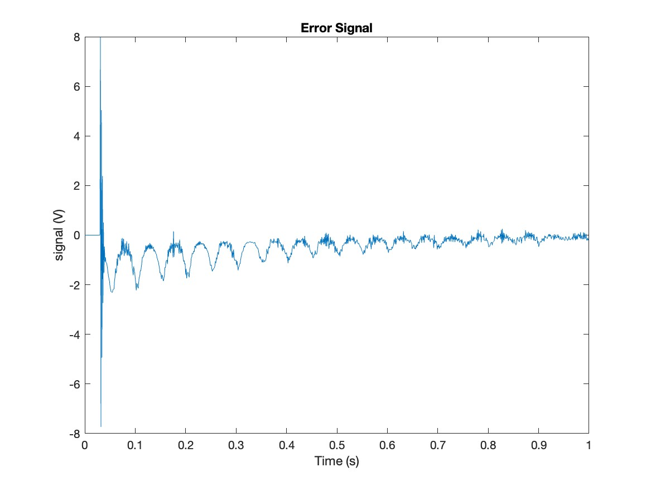
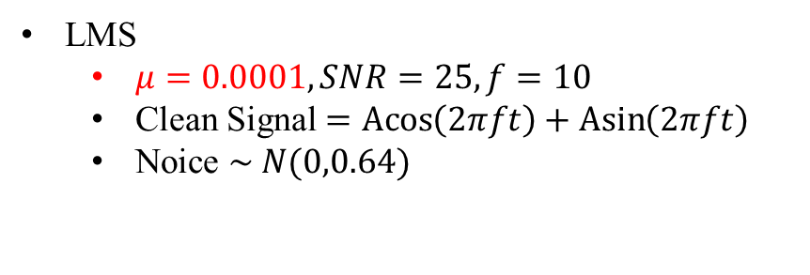
PROJECT
ASP
Performance Analysis
LMS
$μ=0.0001, SNR=25, f=10$
Clean Signal $=\operatorname{Acos}\left(2πft\right)+\operatorname{Asin}\left(2πft\right)$
Noice $\sim N(0,0.64)$
ASP Team18
Project

Slide 14
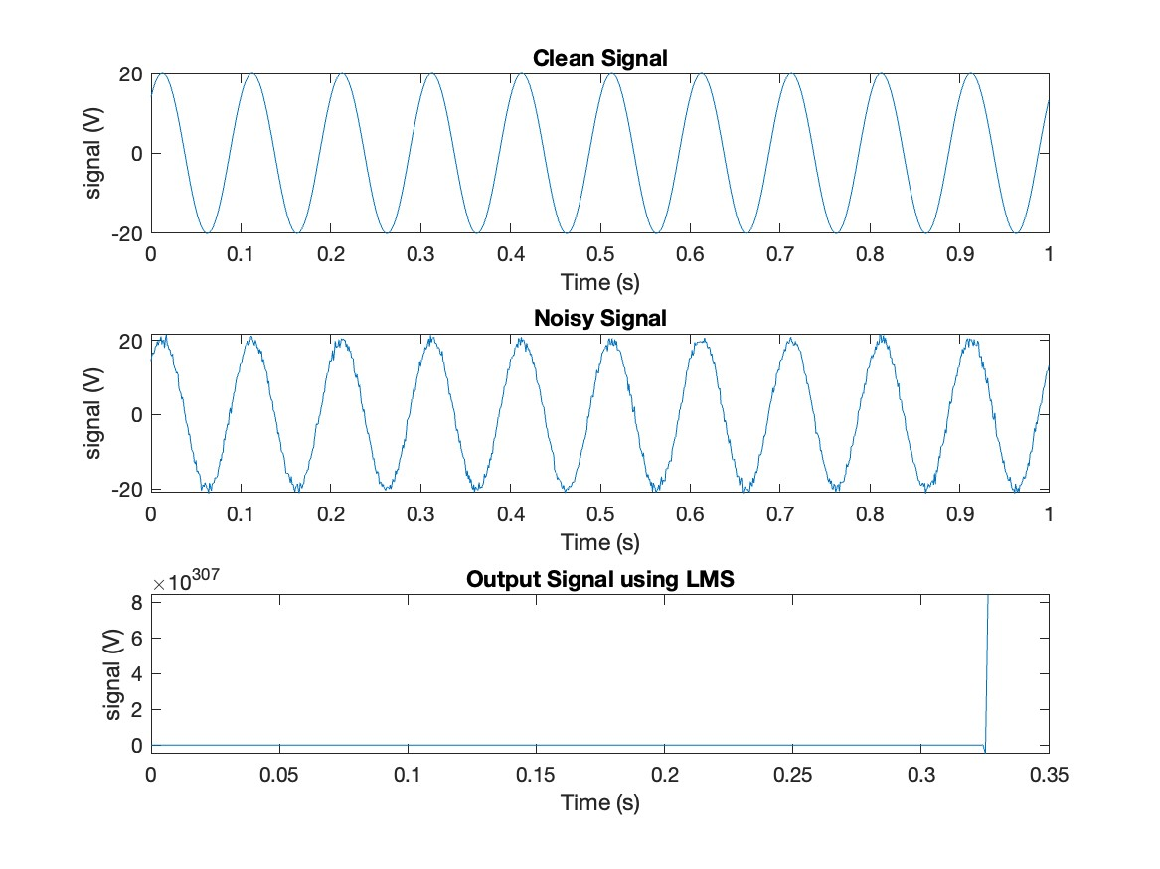
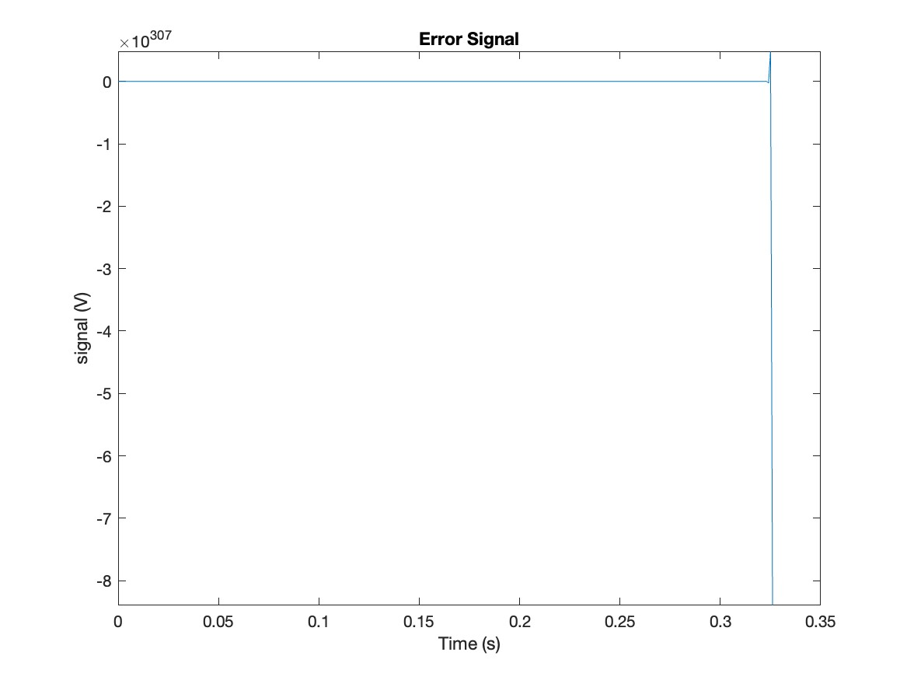
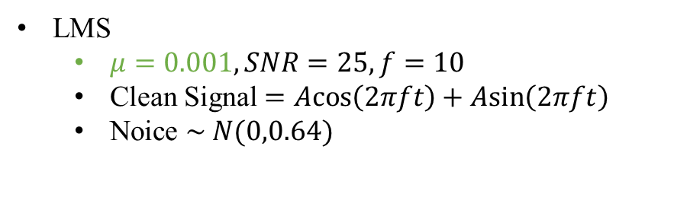
PROJECT
ASP
Performance Analysis
LMS
$μ=0.001, SNR=25, f=10$
Clean Signal $=\operatorname{Acos}\left(2πft\right)+\operatorname{Asin}\left(2πft\right)$
Noice $\sim N(0,0.64)$
ASP Team18
Project

Slide 15
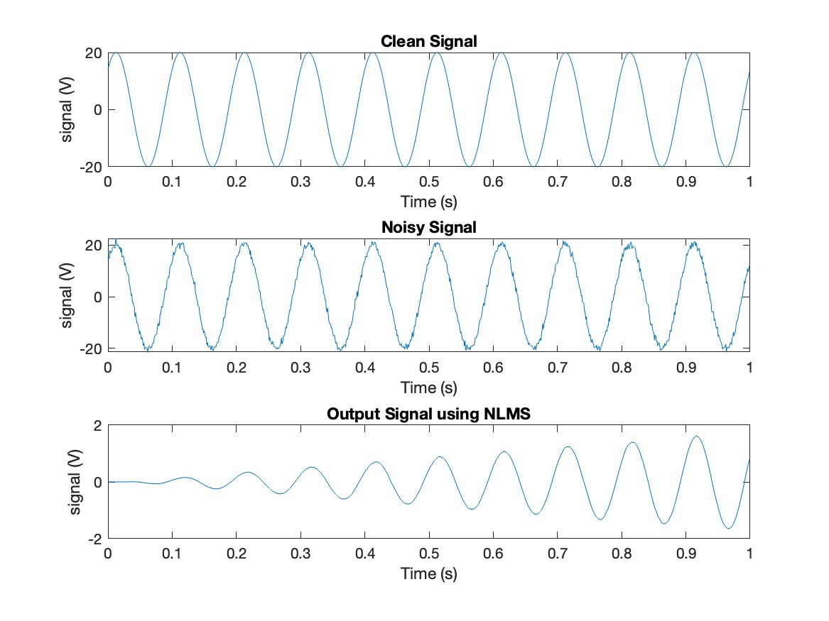
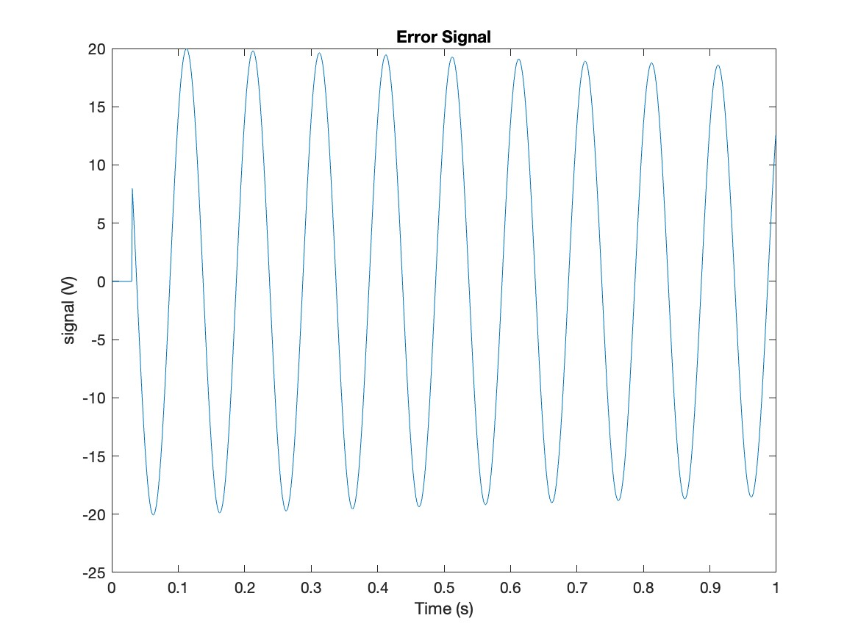

PROJECT
ASP
Performance Analysis
NLMS
$μ=0.0001, SNR=25, f=10$
Clean Signal $=\operatorname{Acos}\left(2πft\right)+\operatorname{Asin}\left(2πft\right)$
Noice $\sim N(0,0.64)$
ASP Team18
Project

Slide 16
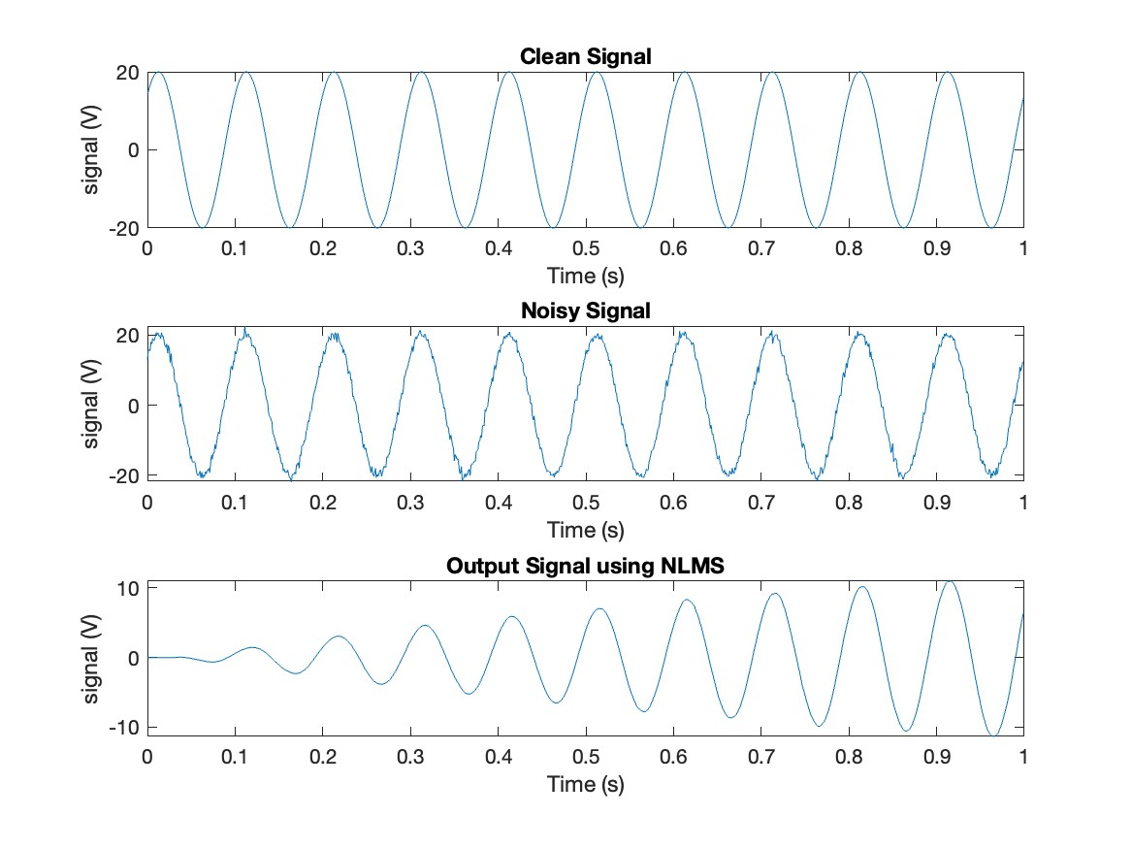
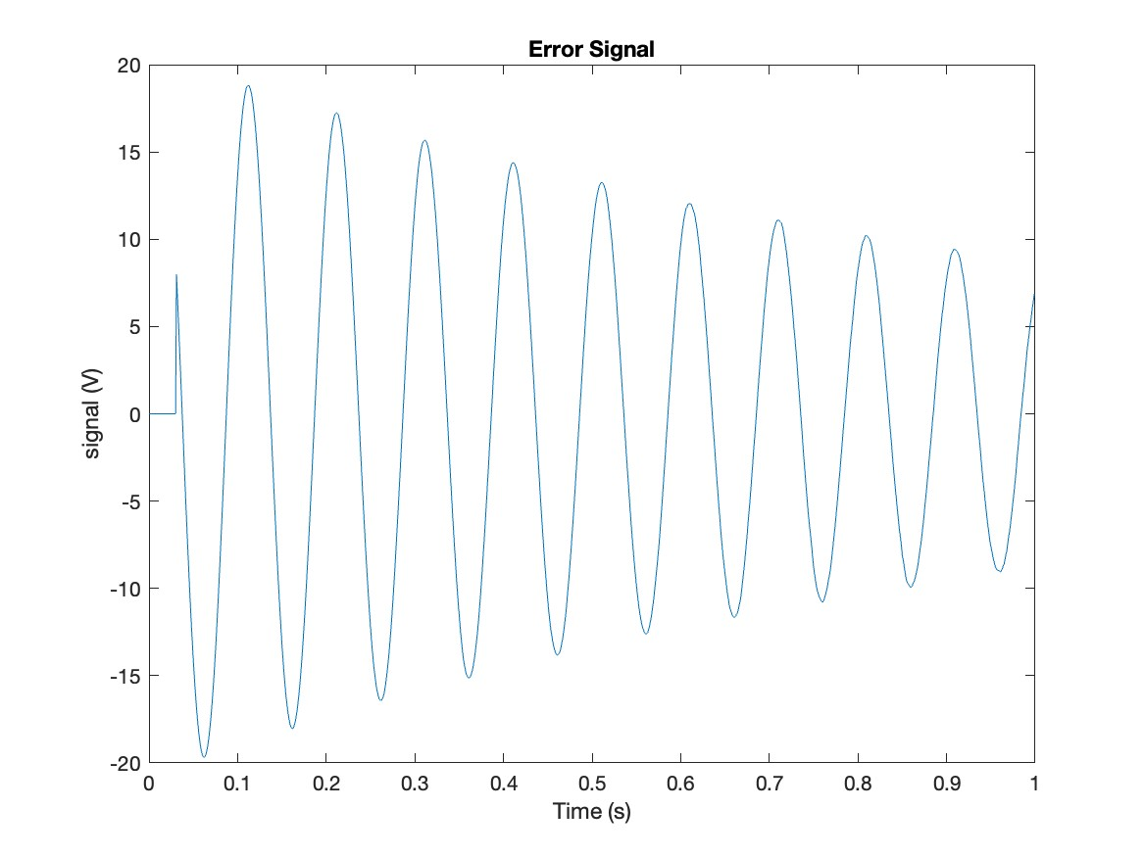

PROJECT
ASP
Performance Analysis
NLMS
$μ=0.001, SNR=25, f=10$
Clean Signal $=\operatorname{Acos}\left(2πft\right)+\operatorname{Asin}\left(2πft\right)$
Noice $\sim N(0,0.64)$
ASP Team18
Project

Slide 17
PROJECT
ASP
Performance Analysis
LMS versus NLMS
ASP Team18
Project

Slide 18
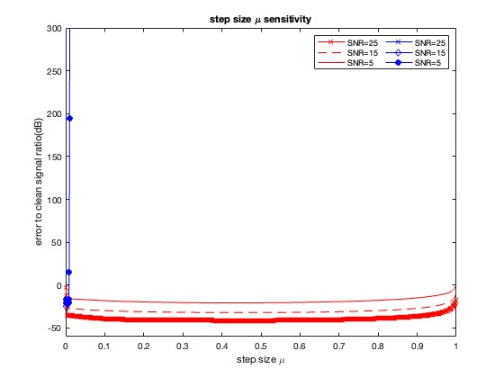
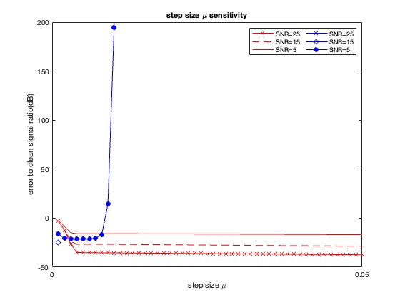
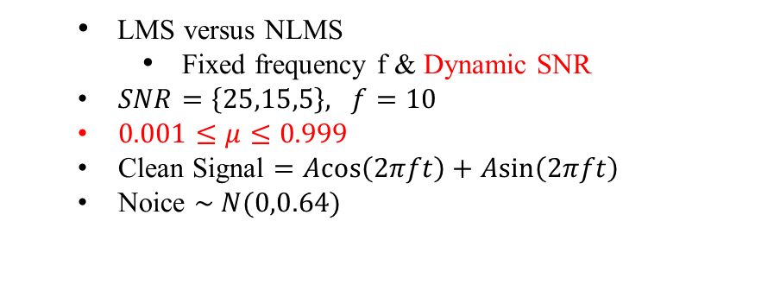
PROJECT
ASP
Performance Analysis
LMS versus NLMS
Fixed frequency f & Dynamic SNR
$SNR=\left\{25,15,5\right\}, f=10$
$0.001≤μ≤0.999$
Clean Signal $=\operatorname{Acos}\left(2πft\right)+\operatorname{Asin}\left(2πft\right)$
Noice $\sim N(0,0.64)$
ASP Team18
Project

Slide 19
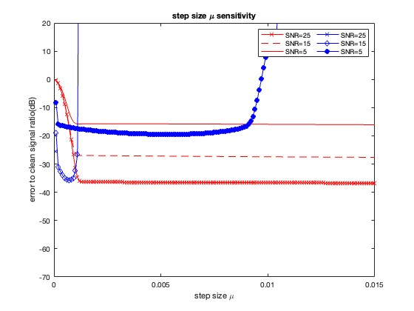
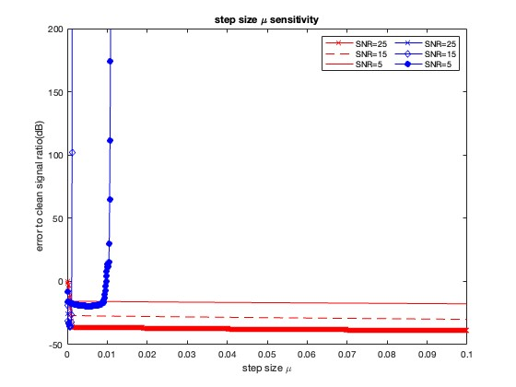
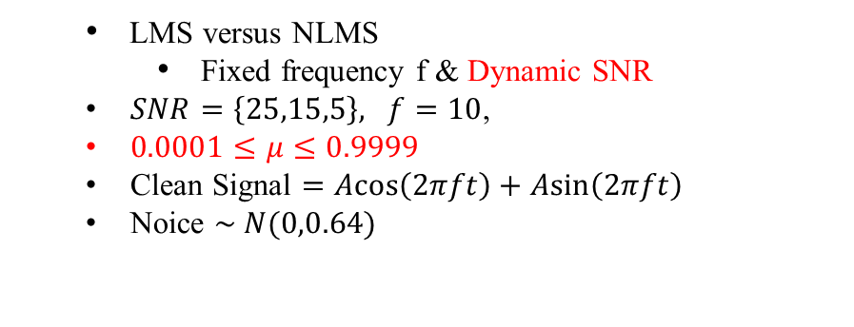
PROJECT
ASP
Performance Analysis
LMS versus NLMS
Fixed SNR & Dynamic frequency
LMS versus NLMS
Fixed frequency f & Dynamic SNR
$SNR=\left\{25,15,5\right\}, f=10$,
$0.0001≤μ≤0.9999$
Clean Signal $=\operatorname{Acos}\left(2πft\right)+\operatorname{Asin}\left(2πft\right)$
Noice $\sim N(0,0.64)$
ASP Team18
Project

Slide 20
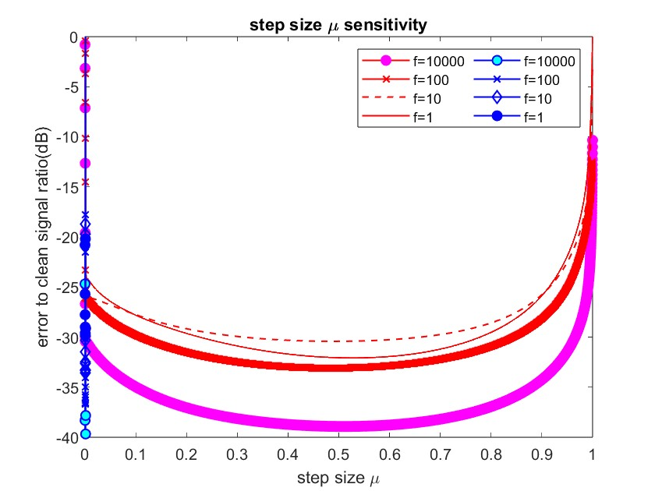
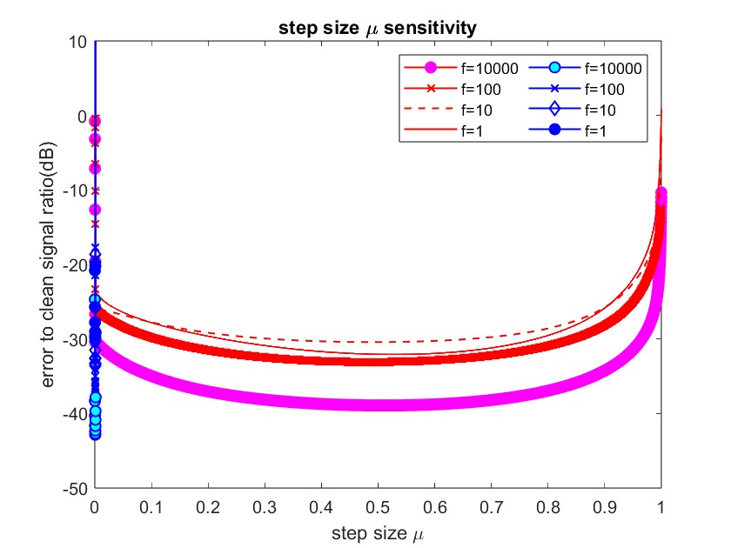
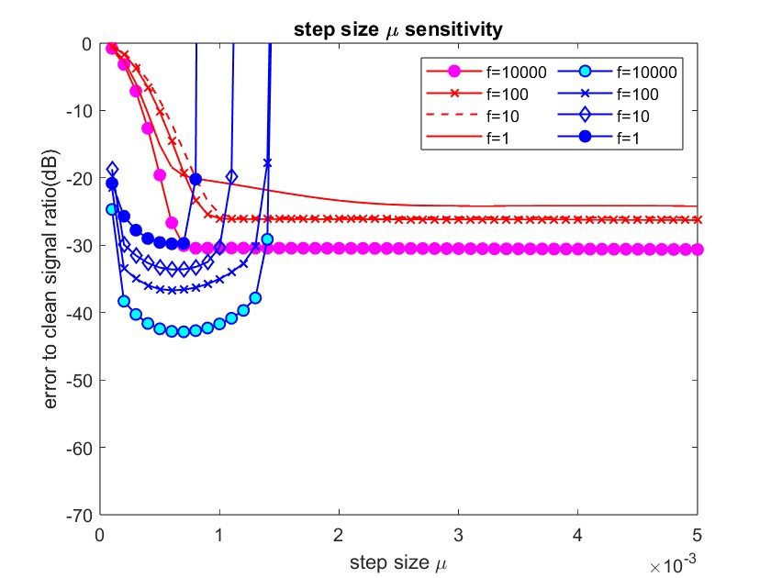
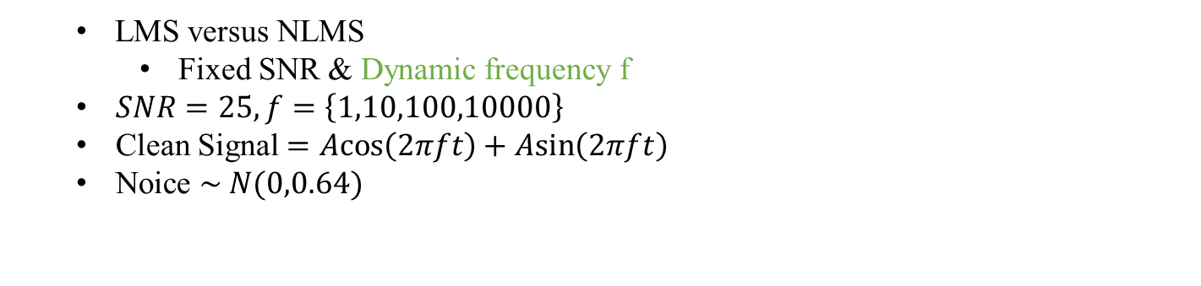
PROJECT
ASP
Performance Analysis
LMS versus NLMS
Fixed SNR & Dynamic frequency
LMS versus NLMS
Fixed SNR & Dynamic frequency f
$SNR=25, f=\left\{1,10,100,10000\right\}$
Clean Signal $=\operatorname{Acos}\left(2πft\right)+\operatorname{Asin}\left(2πft\right)$
Noice $\sim N(0,0.64)$
ASP Team18
Project

Slide 21
PROJECT
ASP
Performance Analysis
APA versus NLMS
ASP Team18
Project

Slide 22
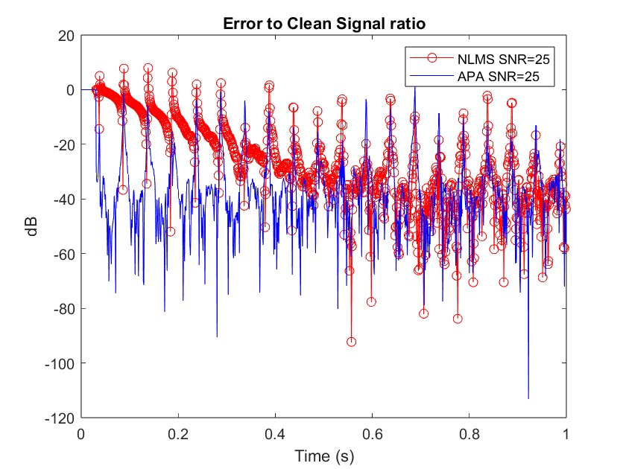
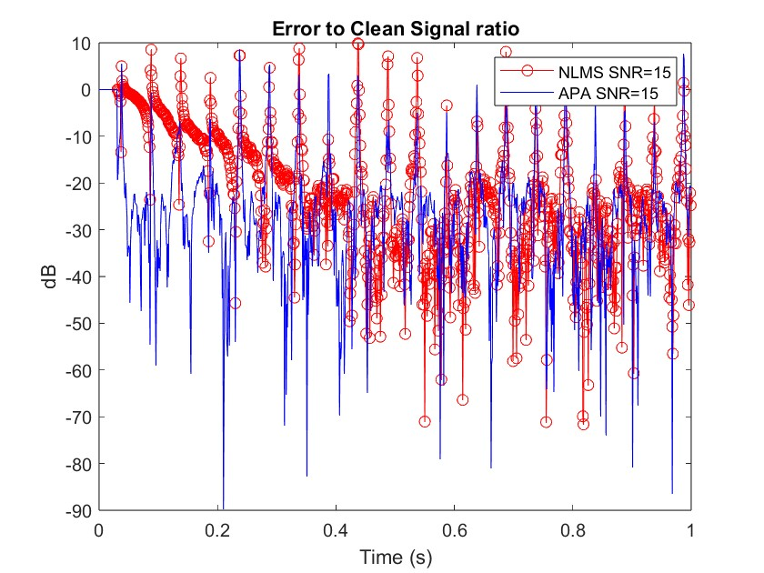
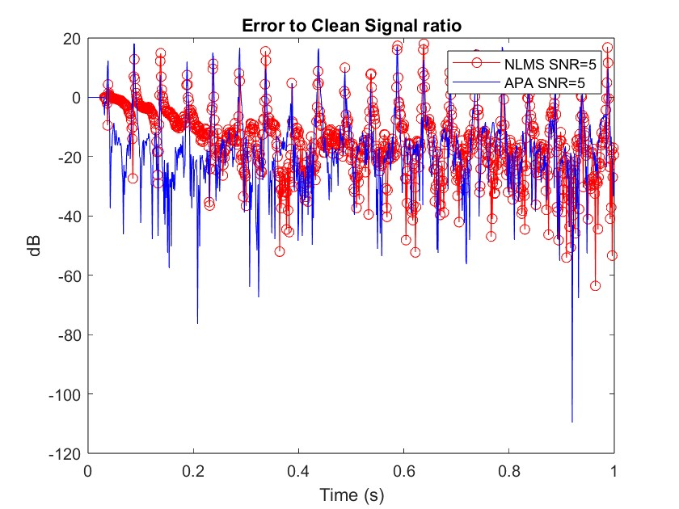
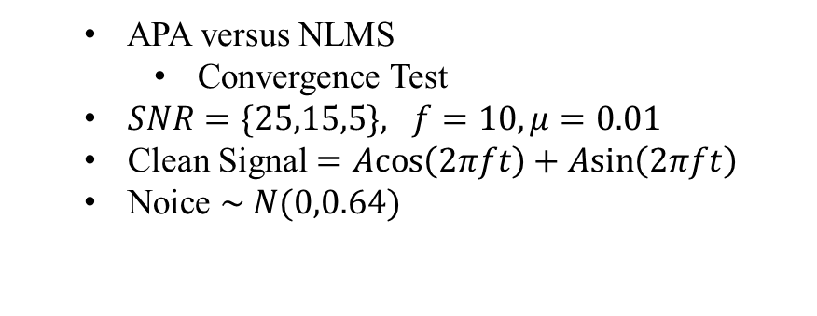
PROJECT
ASP
Performance Analysis
LMS versus NLMS
Fixed SNR & Dynamic frequency
APA versus NLMS
Convergence Test
$SNR=\{25,15,5\}, f=10, μ=0.01$
Clean Signal $=\operatorname{Acos}\left(2πft\right)+\operatorname{Asin}\left(2πft\right)$
Noice $\sim N(0,0.64)$
ASP Team18
Project

Slide 23
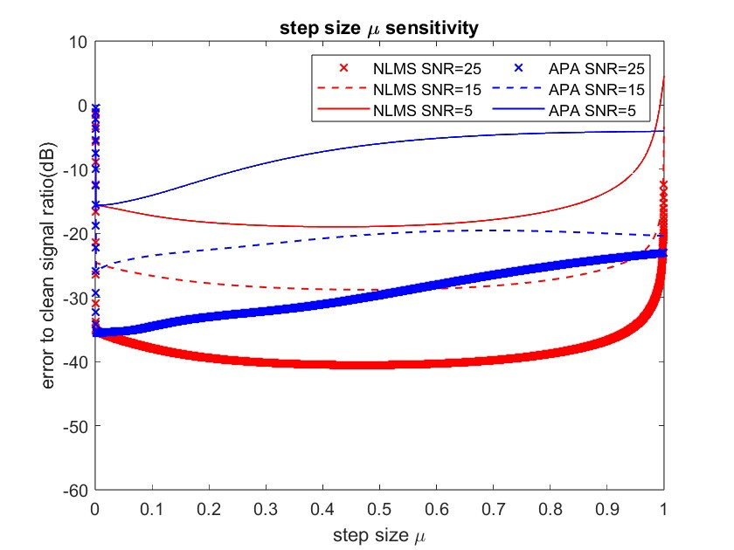
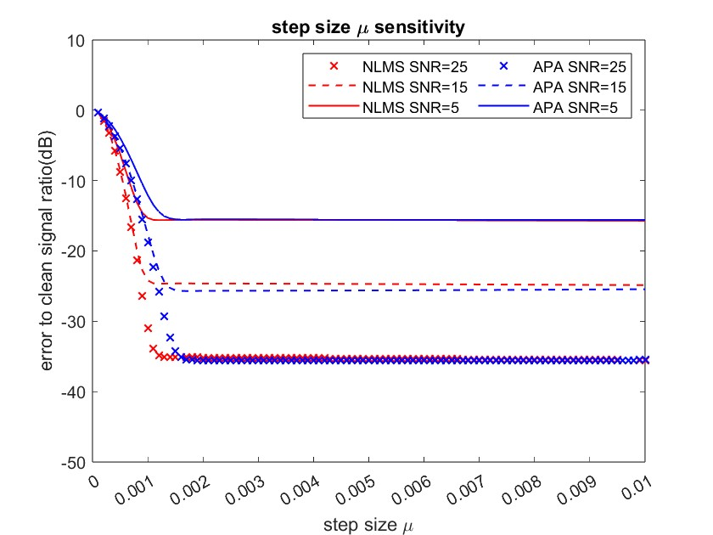
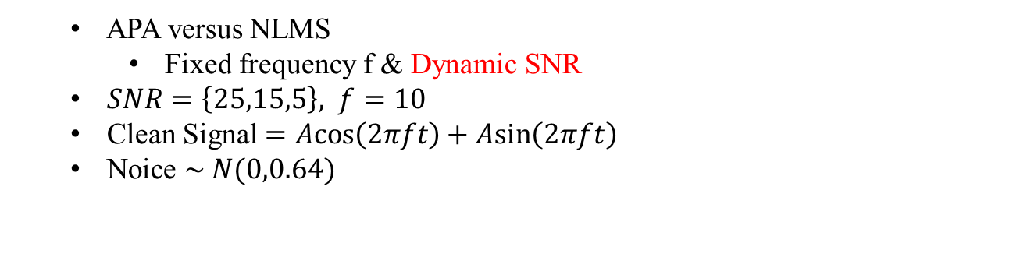
PROJECT
ASP
Performance Analysis
LMS versus NLMS
Fixed SNR & Dynamic frequency
APA versus NLMS
Fixed frequency f & Dynamic SNR
$SNR=\left\{25,15,5\right\}, f=10$
Clean Signal $=\operatorname{Acos}\left(2πft\right)+\operatorname{Asin}\left(2πft\right)$
Noice $\sim N(0,0.64)$
ASP Team18
Project

Slide 24
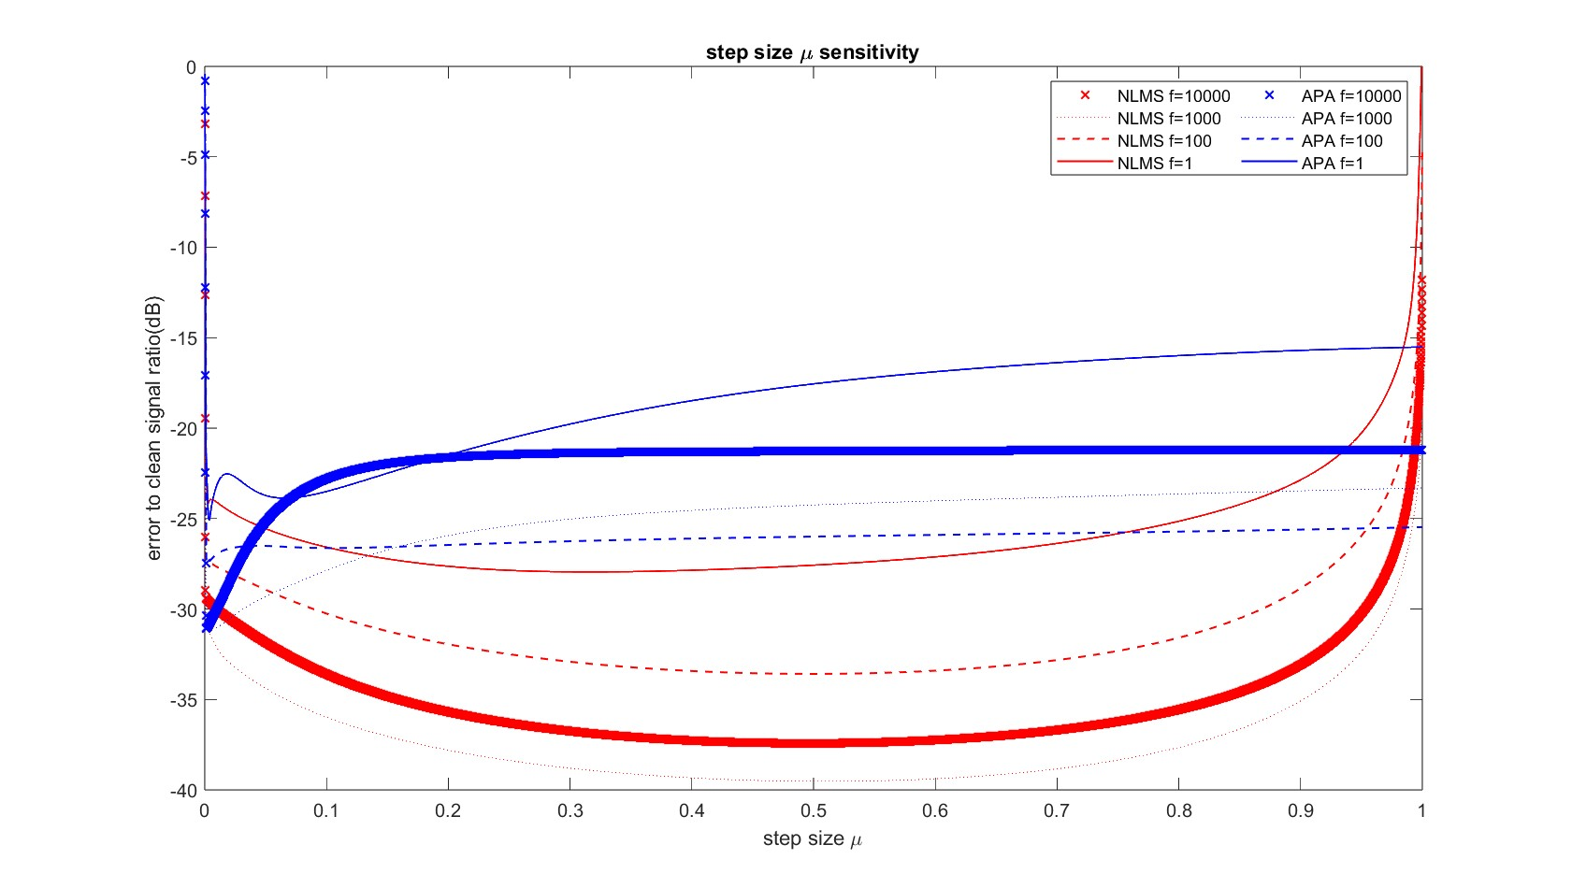
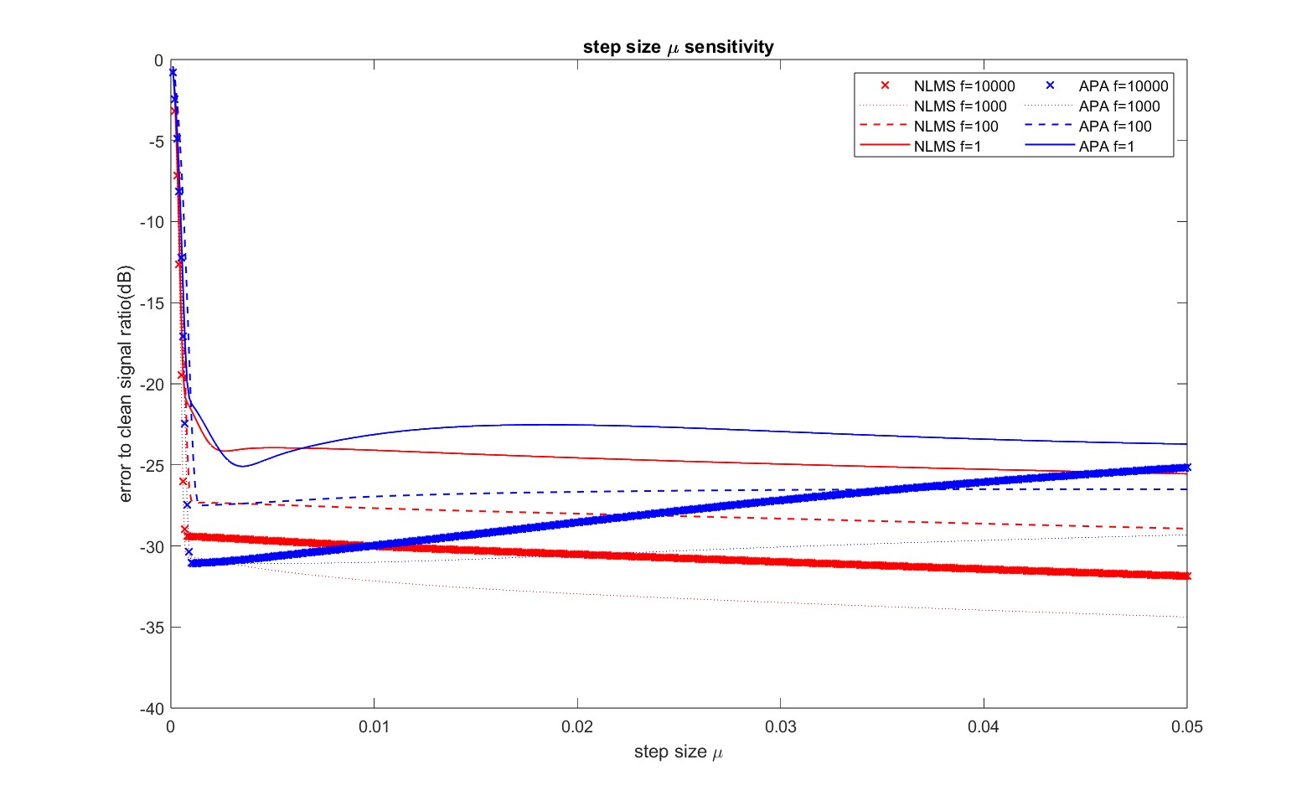
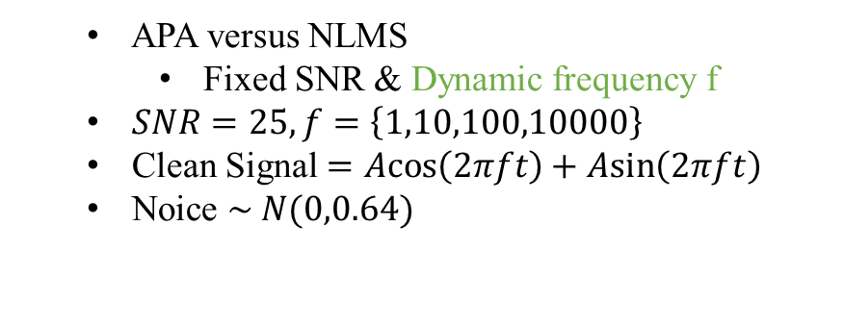
PROJECT
ASP
Performance Analysis
LMS versus NLMS
Fixed SNR & Dynamic frequency
APA versus NLMS
Fixed SNR & Dynamic frequency f
$SNR=25, f=\left\{1,10,100,10000\right\}$
Clean Signal $=\operatorname{Acos}\left(2πft\right)+\operatorname{Asin}\left(2πft\right)$
Noice $\sim N(0,0.64)$
ASP Team18
Project

